Slide 1



Regional Sales Data Analysis Project
A comprehensive analysis using Python, SQL, and Power BI
Following the EDA approach

Slide 2
Table of contents
01
04
02
05
03
06
Questions & Insights (SQL Queries)
Introduction
Data Modeling & Visualization (Power BI)
Data Overview
Data Cleaning (Python)
Conclusion

Slide 3

01
Introduction

Slide 4
Objective:
The main goal of this project was to analyze store sales data to gain insights into sales performance, customer behavior, and product profitability. By leveraging tools like Python for data cleaning, SQL for querying the database, and Power BI for creating visualizations, the project aimed to provide actionable recommendations to improve business outcomes.

Slide 5
Scope:
The data analysis focused on several key areas:
Sales Trends: Understanding overall sales performance across different channels, time periods, and locations.
Customer Insights: Identifying key customer demographics and purchasing patterns to improve targeted marketing.
Product Profitability: Assessing which products generate the highest profit and identifying underperforming products.
Regional Performance: Analyzing sales across various regions and stores to optimize distribution and warehouse strategies.

Slide 6
Tools Used:
Python: Used for cleaning and preparing the dataset, handling missing values, standardizing data formats, and performing basic exploratory data analysis.
SQL: Employed to answer key business questions related to sales, customers, and products, including filtering and aggregating data.
Power BI: Used for building interactive dashboards to visualize sales trends, customer demographics, and other insights.

Slide 7
Key Insights:
Sales Performance: Identified the best-performing sales channels and time periods, showing seasonal spikes.
Customer Analysis: Discovered that higher-income households tend to spend more, especially in specific product categories.
Product Profitability: Determined the most profitable products and those that required improvement or discounting.
Regional Analysis: Revealed regional disparities in sales, with certain warehouses and states performing significantly better than others.

Slide 8
Deliverables:
Cleaned and structured data tables for efficient analysis.
SQL queries to answer specific business-related questions.
Power BI dashboards with visual insights for sales, customer, and product data.

Slide 9
02
Data Overview

Slide 10
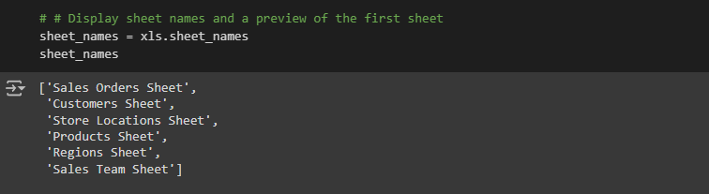
Data Discription
The dataset used in this analysis consists of multiple tables, each representing different aspects of the store’s sales operations.
The data is structured to provide insights into sales transactions, customer information, store locations, and products, with key metrics such as order quantities, discounts, prices, and profits.

Slide 11
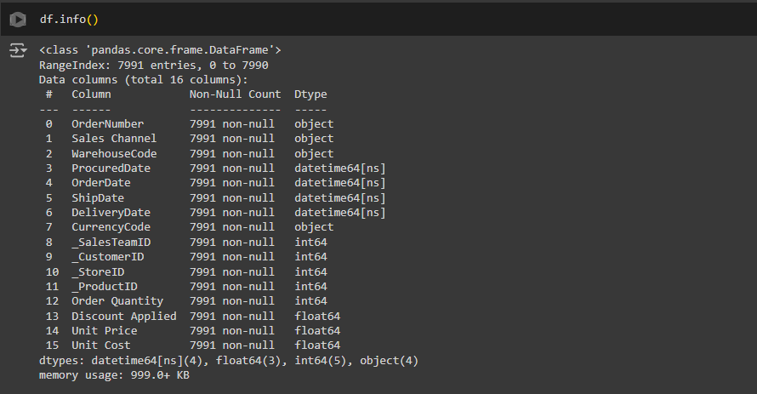

Slide 12
03
Data Cleaning (Python)

Slide 13
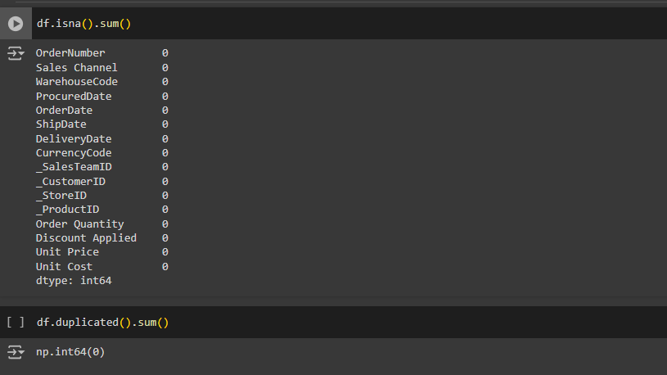
Confirming no missing values & no duplicates

Slide 14
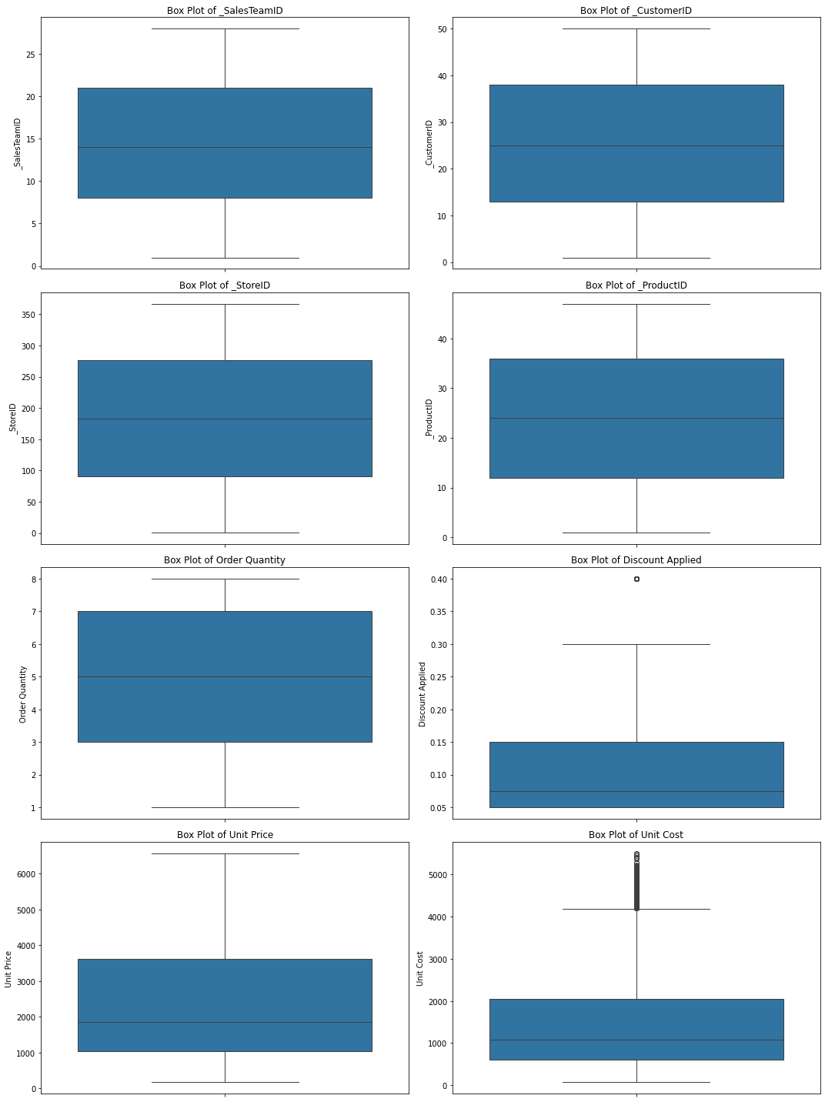
Box plots for outlier visualization

Slide 15
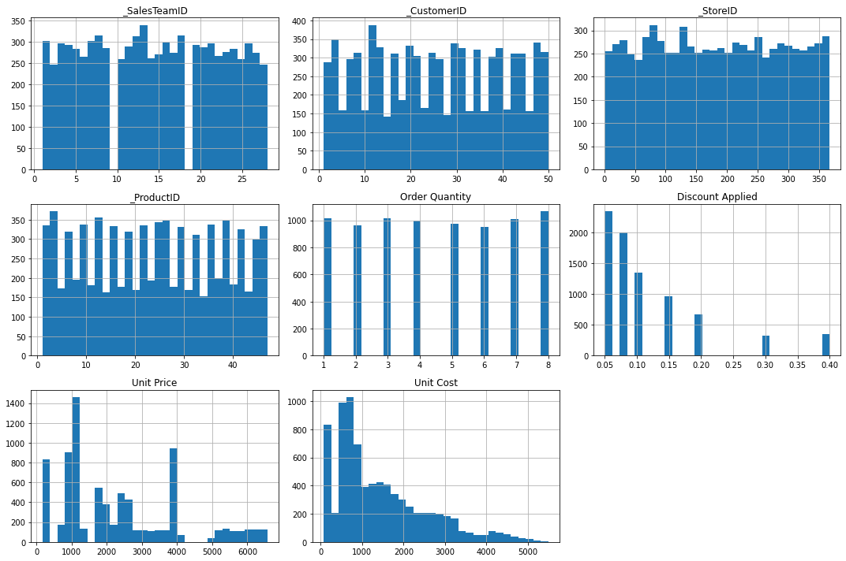
histograms

Slide 16
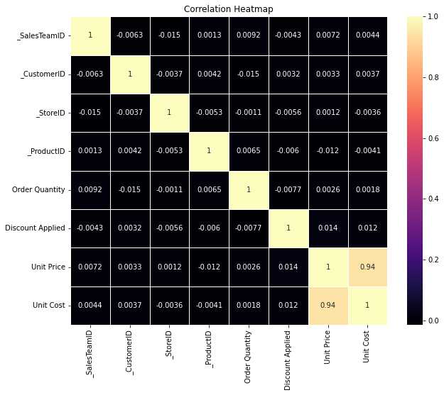
Correlation heatmap

Slide 17
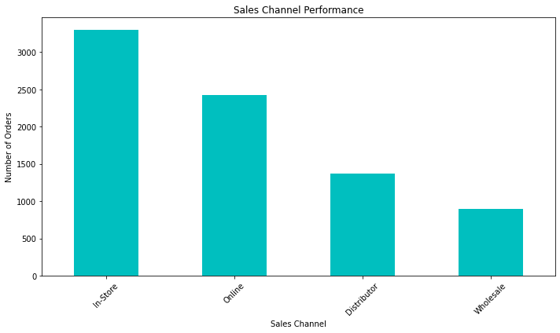

Slide 18
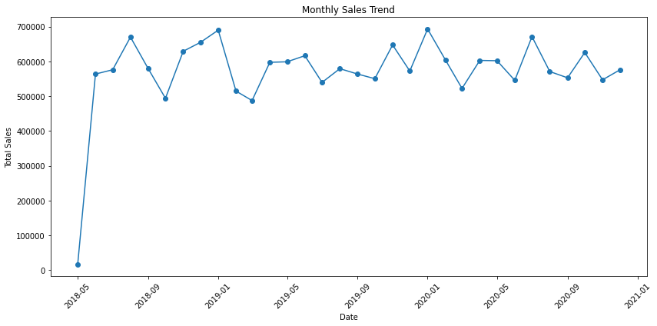

Slide 19
04
Questions & Insights (SQL Queries)

Slide 20
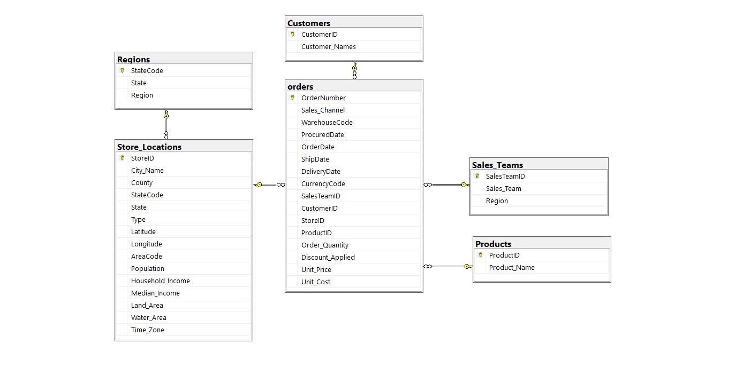
Data Modeling

Slide 21
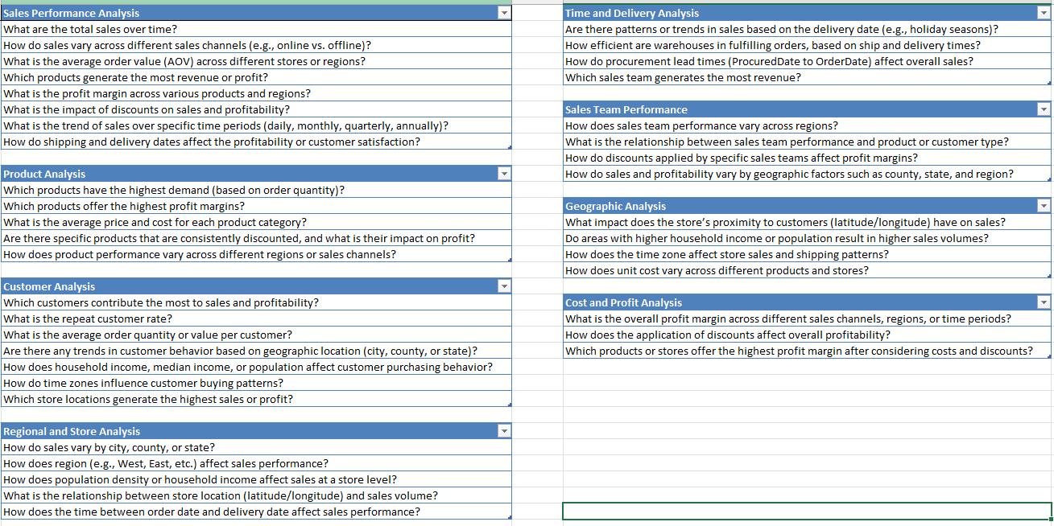
All Questions

Slide 22
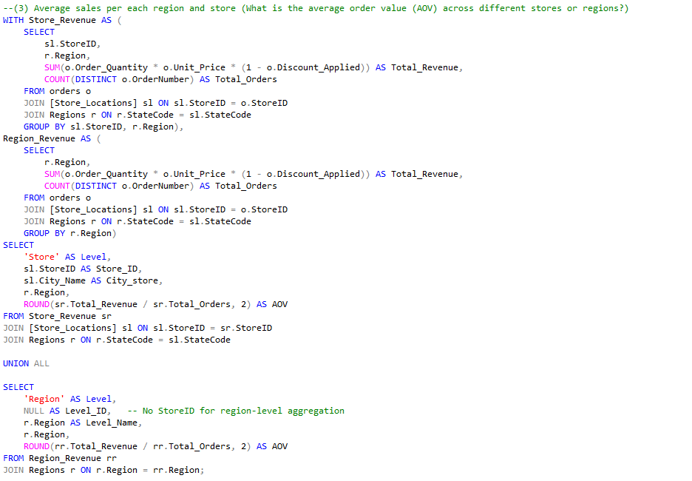
Answers Samples

Slide 23
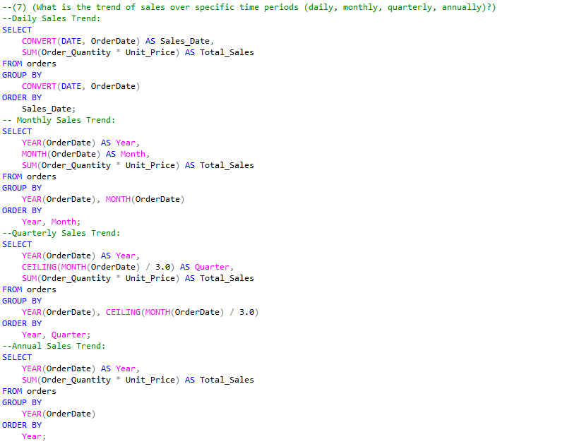

Slide 24
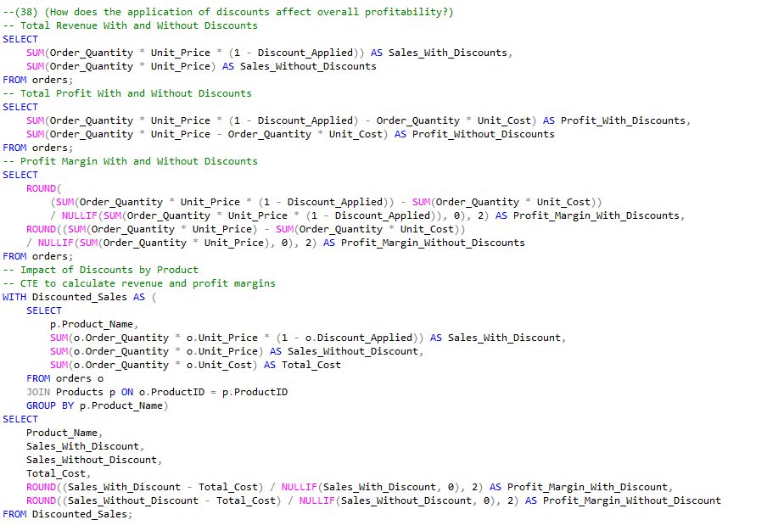

Slide 25
05
Data Modeling & Visualization (Power BI)

Slide 26
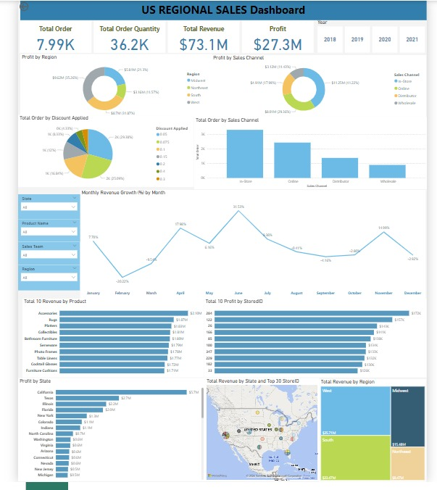
Dashboard
Results & Key Findings:
Sales Channels: Online sales are growing significantly faster than in-store sales.
Discount Strategy: While discounts drive sales, they negatively impact profit margins.
Top Products: Cookware is the best-performing product by revenue, but photo frames yield the highest profit margins.
Regional Performance: The South region dominates in terms of sales volume, while the West region excels in profitability.
Customer Insights: Repeat customers, especially corporate clients, are a crucial driver of profitability.

Slide 27
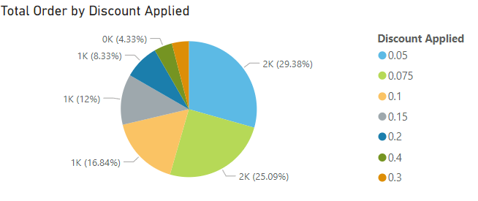
Question: What is the impact of discounts on sales and profitability?
Optimize Discount Strategies: Focus on strategic discounting for high-margin products to boost sales without significantly impacting profitability.

Slide 28
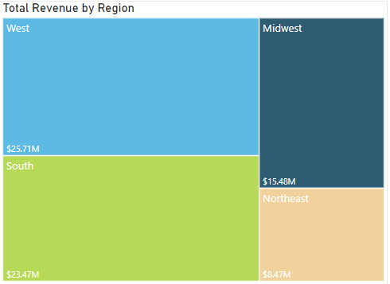
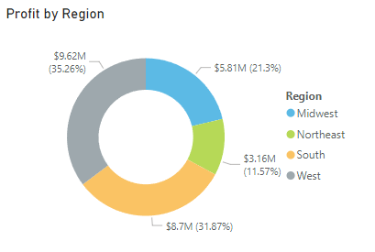
Question: What is the average order value (AOV) across different stores or regions?
Focus on the West Region: Expand operations in the West, where higher AOV and profitability are observed.

Slide 29
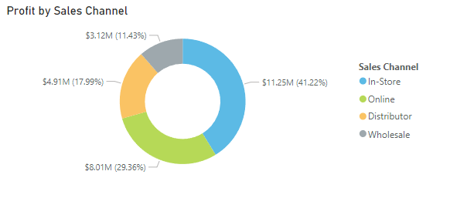
Question: How do sales vary across different sales channels (e.g., online vs. offline)?
Enhance Online Sales Channels: Invest in online marketing and logistics to capitalize on the growing online sales trend.

Slide 30
06
Conclusion

Slide 31
Conclusion
This project successfully analyzed store sales data by utilizing a combination of Python, SQL, and Power BI. The analysis provided valuable insights into sales performance, customer demographics, product profitability, and regional disparities. By standardizing and cleaning the data, we ensured that the information was consistent and reliable for decision-making.
The regional sales analysis provided critical insights into how sales performance varies across channels, products, and regions. By optimizing discount strategies, focusing on profitable regions, and enhancing online channels, the company can achieve sustainable growth.

Slide 32
Key insights include:
Sales Performance Trends: Identified best-selling periods and most effective sales channels.
Customer Insights: High-income households were found to be key drivers of sales, indicating opportunities for targeted marketing.
Product Profitability: Certain products contributed disproportionately to profits, while others showed opportunities for improvement.
Regional Disparities: Specific regions outperformed others, suggesting the need for a re-evaluation of distribution strategies.
By visualizing these insights using Power BI, the findings were made accessible and actionable, guiding future business strategies aimed at maximizing sales efficiency and profitability.

Slide 33
Thanks !
Do you have any questions for us?

Slide 34
Our Mentor
Mennatullah Selim
Presenters
Ahmed Mokhtar Mohamed
Abdulrahman Wheed
Ali Abdulhalim
Maher Ahmed
Mahmoud Mounir

Slide 35
Resources
All sources and files for the project can be found here:
https://drive.google.com/drive/folders/1-4awDQFdIegQ6lt8vTOiehB-_PF3XRDf?usp=sharing

